Slide 1
Implementing Data Visualization (II)
Notes:
With the knowledge of the first two sessions, in this session we will focus more on the practical implementations of different visualizations.

Slide 2
Visualizing distributions with Histograms and Density Plots
Notes:
Most often we would like to investigate the distributions of a particular variable in the dataset, not just comparing the amount of different categories.
Amount: compare number of different categories.
Distributions: examining the data in a specific category.
Histogram shows the frequency of values in data by grouping it into equal-sized intervals or classes (so-called bins). In such a way, it gives you an idea about the approximate probability distribution of your quantitative data.

Slide 3
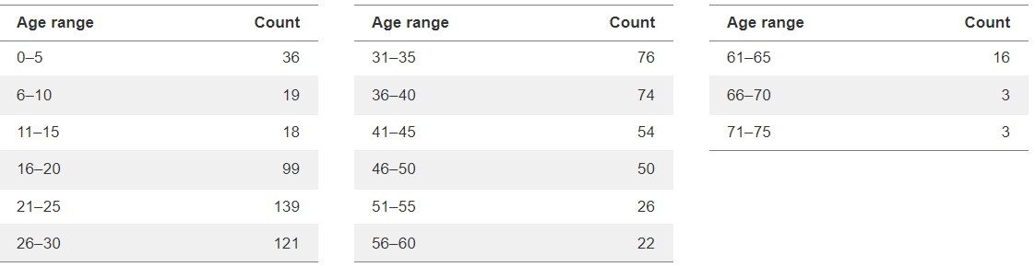
Visualizing a single distribution
Considering the dataset of Titanic, we want to investigate the age distribution of passengers, how should we do?
We need to count the frequencies of each age category
Notes:
Here, we first categorized ages into different groups, and then count the frequencies of each age category.

Slide 4
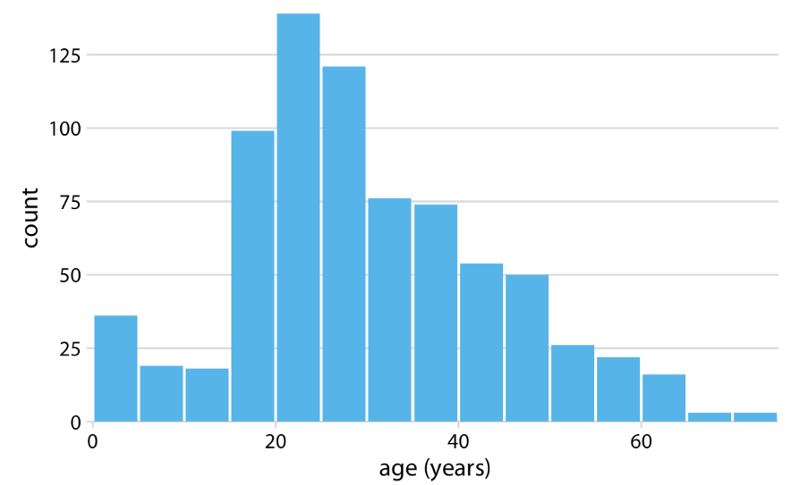
Visualizing a single distribution
Histogram to show the frequencies of each category
Notes:
As always, the heights of the bars should represent the number. Unlike the bar charts, the width of the bar in histogram has a meaning indicating width of the age bins.

Slide 5
Insights
The bin size is defined by human subjectively
The appearance of histogram is determined by the bin size
If the bin size is too small, the histogram becomes very peaky and visually busy and main trends in the data may be obscured. If the bin size is too large, smaller features in the dataset will be disappear.
Try different bin sizes, do not always depend on the default bin sized provided by the visualization package

Slide 6
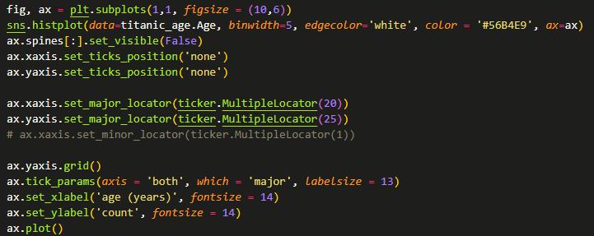
How to implement?

Slide 7
Visualizing a single distribution
Density distribution
In the density estimation, we attempt to visualize the underlying probability distribution of the data by drawing appropriate continuous curve. This curve needs to be estimated from data.
Two ways of estimating
Parametric Density Estimation: The shape of a histogram of most random samples will match a well-known probability distribution, and then calculated the parameters for the distribution based on the samples
Nonparametric Density Estimation: In some cases, a data sample may not resemble a common probability distribution or cannot be easily made to fit the distribution. An algorithm is used to approximate the probability distribution of the data without a pre-defined distribution, referred to as a nonparametric method.
Notes:
The shape of a histogram of most random samples will match a well-known probability distribution.
The common distributions are common because they occur again and again in different and sometimes unexpected domains.
Get familiar with the common probability distributions as it will help you to identify a given distribution from a histogram.
Once identified, you can attempt to estimate the density of the random variable with a chosen probability distribution. This can be achieved by estimating the parameters of the distribution from a random sample of data.
A Gentle Introduction to Probability Density Estimation
by Jason Brownlee on September 25, 2019 in Probability
Tweet Tweet Share Share
Last Updated on July 24, 2020
Probability density is the relationship between observations and their probability.
Some outcomes of a random variable will have low probability density and other outcomes will have a high probability density.
The overall shape of the probability density is referred to as a probability distribution, and the calculation of probabilities for specific outcomes of a random variable is performed by a probability density function, or PDF for short.
It is useful to know the probability density function for a sample of data in order to know whether a given observation is unlikely, or so unlikely as to be considered an outlier or anomaly and whether it should be removed. It is also helpful in order to choose appropriate learning methods that require input data to have a specific probability distribution.
It is unlikely that the probability density function for a random sample of data is known. As such, the probability density must be approximated using a process known as probability density estimation.
In this tutorial, you will discover a gentle introduction to probability density estimation.
After completing this tutorial, you will know:
Histogram plots provide a fast and reliable way to visualize the probability density of a data sample.
Parametric probability density estimation involves selecting a common distribution and estimating the parameters for the density function from a data sample.
Nonparametric probability density estimation involves using a technique to fit a model to the arbitrary distribution of the data, like kernel density estimation.
Kick-start your project with my new book Probability for Machine Learning, including step-by-step tutorials and the Python source code files for all examples.
Let’s get started.
A Gentle Introduction to Probability Density Estimation Photo by Alistair Paterson, some rights reserved.
Tutorial Overview
This tutorial is divided into four parts; they are:
Probability Density
Summarize Density With a Histogram
Parametric Density Estimation
Nonparametric Density Estimation
Probability Density
A random variable x has a probability distribution p(x).
The relationship between the outcomes of a random variable and its probability is referred to as the probability density, or simply the “density.”
If a random variable is continuous, then the probability can be calculated via probability density function, or PDF for short. The shape of the probability density function across the domain for a random variable is referred to as the probability distribution and common probability distributions have names, such as uniform, normal, exponential, and so on.
Given a random variable, we are interested in the density of its probabilities.
For example, given a random sample of a variable, we might want to know things like the shape of the probability distribution, the most likely value, the spread of values, and other properties.
Knowing the probability distribution for a random variable can help to calculate moments of the distribution, like the mean and variance, but can also be useful for other more general considerations, like determining whether an observation is unlikely or very unlikely and might be an outlier or anomaly.
The problem is, we may not know the probability distribution for a random variable. We rarely do know the distribution because we don’t have access to all possible outcomes for a random variable. In fact, all we have access to is a sample of observations. As such, we must select a probability distribution.
This problem is referred to as probability density estimation, or simply “density estimation,” as we are using the observations in a random sample to estimate the general density of probabilities beyond just the sample of data we have available.
There are a few steps in the process of density estimation for a random variable.
The first step is to review the density of observations in the random sample with a simple histogram. From the histogram, we might be able to identify a common and well-understood probability distribution that can be used, such as a normal distribution. If not, we may have to fit a model to estimate the distribution.
In the following sections, we will take a closer look at each one of these steps in turn.
We will focus on univariate data, e.g. one random variable, in this post for simplicity. Although the steps are applicable for multivariate data, they can become more challenging as the number of variables increases.
Want to Learn Probability for Machine Learning
Take my free 7-day email crash course now (with sample code).
Click to sign-up and also get a free PDF Ebook version of the course.
Download Your FREE Mini-Course
Summarize Density With a Histogram
The first step in density estimation is to create a histogram of the observations in the random sample.
A histogram is a plot that involves first grouping the observations into bins and counting the number of events that fall into each bin. The counts, or frequencies of observations, in each bin are then plotted as a bar graph with the bins on the x-axis and the frequency on the y-axis.
The choice of the number of bins is important as it controls the coarseness of the distribution (number of bars) and, in turn, how well the density of the observations is plotted. It is a good idea to experiment with different bin sizes for a given data sample to get multiple perspectives or views on the same data.
For example, observations between 1 and 100 could be split into 3 bins (1-33, 34-66, 67-100), which might be too coarse, or 10 bins (1-10, 11-20, … 91-100), which might better capture the density.
A histogram can be created using the Matplotlib library and the hist() function. The data is provided as the first argument, and the number of bins is specified via the “bins” argument either as an integer (e.g. 10) or as a sequence of the boundaries of each bin (e.g. [1, 34, 67, 100]).
The snippet below creates a histogram with 10 bins for a data sample.
1
2
3
4
...
# plot a histogram of the sample
pyplot.hist(sample, bins=10)
pyplot.show()
We can create a random sample drawn from a normal distribution and pretend we don’t know the distribution, then create a histogram of the data. The normal() NumPy function will achieve this and we will generate 1,000 samples with a mean of 0 and a standard deviation of 1, e.g. a standard Gaussian.
The complete example is listed below.
1
2
3
4
5
6
7
8
# example of plotting a histogram of a random sample
from matplotlib import pyplot
from numpy.random import normal
# generate a sample
sample = normal(size=1000)
# plot a histogram of the sample
pyplot.hist(sample, bins=10)
pyplot.show()
Running the example draws a sample of random observations and creates the histogram with 10 bins. We can clearly see the shape of the normal distribution.
Note that your results will differ given the random nature of the data sample. Try running the example a few times.
Histogram Plot With 10 Bins of a Random Data Sample
Running the example with bins set to 3 makes the normal distribution less obvious.
Histogram Plot With 3 Bins of a Random Data Sample
Reviewing a histogram of a data sample with a range of different numbers of bins will help to identify whether the density looks like a common probability distribution or not.
In most cases, you will see a unimodal distribution, such as the familiar bell shape of the normal, the flat shape of the uniform, or the descending or ascending shape of an exponential or Pareto distribution.
You might also see complex distributions, such as multiple peaks that don’t disappear with different numbers of bins, referred to as a bimodal distribution, or multiple peaks, referred to as a multimodal distribution. You might also see a large spike in density for a given value or small range of values indicating outliers, often occurring on the tail of a distribution far away from the rest of the density.
Parametric Density Estimation
The shape of a histogram of most random samples will match a well-known probability distribution.
The common distributions are common because they occur again and again in different and sometimes unexpected domains.
Get familiar with the common probability distributions as it will help you to identify a given distribution from a histogram.
Once identified, you can attempt to estimate the density of the random variable with a chosen probability distribution. This can be achieved by estimating the parameters of the distribution from a random sample of data.
For example, the normal distribution has two parameters: the mean and the standard deviation. Given these two parameters, we now know the probability distribution function. These parameters can be estimated from data by calculating the sample mean and sample standard deviation.
We refer to this process as parametric density estimation.
The reason is that we are using predefined functions to summarize the relationship between observations and their probability that can be controlled or configured with parameters, hence “parametric“.
Once we have estimated the density, we can check if it is a good fit. This can be done in many ways, such as:
Plotting the density function and comparing the shape to the histogram.
Sampling the density function and comparing the generated sample to the real sample.
Using a statistical test to confirm the data fits the distribution.
We can demonstrate this with an example.
We can generate a random sample of 1,000 observations from a normal distribution with a mean of 50 and a standard deviation of 5.
1
2
3
...
# generate a sample
sample = normal(loc=50, scale=5, size=1000)
We can then pretend that we don’t know the probability distribution and maybe look at a histogram and guess that it is normal. Assuming that it is normal, we can then calculate the parameters of the distribution, specifically the mean and standard deviation.
We would not expect the mean and standard deviation to be 50 and 5 exactly given the small sample size and noise in the sampling process.
1
2
3
4
5
...
# calculate parameters
sample_mean = mean(sample)
sample_std = std(sample)
print('Mean=%.3f, Standard Deviation=%.3f' % (sample_mean, sample_std))
Then fit the distribution with these parameters, so-called parametric density estimation of our data sample.
In this case, we can use the norm() SciPy function.
1
2
3
...
# define the distribution
dist = norm(sample_mean, sample_std)
We can then sample the probabilities from this distribution for a range of values in our domain, in this case between 30 and 70.
1
2
3
4
...
# sample probabilities for a range of outcomes
values = [value for value in range(30, 70)]
probabilities = [dist.pdf(value) for value in values]
Finally, we can plot a histogram of the data sample and overlay a line plot of the probabilities calculated for the range of values from the PDF.
Importantly, we can convert the counts or frequencies in each bin of the histogram to a normalized probability to ensure the y-axis of the histogram matches the y-axis of the line plot. This can be achieved by setting the “density” argument to “True” in the call to hist().
1
2
3
4
...
# plot the histogram and pdf
pyplot.hist(sample, bins=10, density=True)
pyplot.plot(values, probabilities)
Tying these snippets together, the complete example of parametric density estimation is listed below.
1
2
3
4
5
6
7
8
9
10
11
12
13
14
15
16
17
18
19
20
21
# example of parametric probability density estimation
from matplotlib import pyplot
from numpy.random import normal
from numpy import mean
from numpy import std
from scipy.stats import norm
# generate a sample
sample = normal(loc=50, scale=5, size=1000)
# calculate parameters
sample_mean = mean(sample)
sample_std = std(sample)
print('Mean=%.3f, Standard Deviation=%.3f' % (sample_mean, sample_std))
# define the distribution
dist = norm(sample_mean, sample_std)
# sample probabilities for a range of outcomes
values = [value for value in range(30, 70)]
probabilities = [dist.pdf(value) for value in values]
# plot the histogram and pdf
pyplot.hist(sample, bins=10, density=True)
pyplot.plot(values, probabilities)
pyplot.show()
Running the example first generates the data sample, then estimates the parameters of the normal probability distribution.
Note that your results will differ given the random nature of the data sample. Try running the example a few times.
In this case, we can see that the mean and standard deviation have some noise and are slightly different from the expected values of 50 and 5 respectively. The noise is minor and the distribution is expected to still be a good fit.
1
Mean=49.852, Standard Deviation=5.023
Next, the PDF is fit using the estimated parameters and the histogram of the data with 10 bins is compared to probabilities for a range of values sampled from the PDF.
We can see that the PDF is a good match for our data.
Data Sample Histogram With Probability Density Function Overlay for the Normal Distribution
It is possible that the data does match a common probability distribution, but requires a transformation before parametric density estimation.
For example, you may have outlier values that are far from the mean or center of mass of the distribution. This may have the effect of giving incorrect estimates of the distribution parameters and, in turn, causing a poor fit to the data. These outliers should be removed prior to estimating the distribution parameters.
Another example is the data may have a skew or be shifted left or right. In this case, you might need to transform the data prior to estimating the parameters, such as taking the log or square root, or more generally, using a power transform like the Box-Cox transform.
These types of modifications to the data may not be obvious and effective parametric density estimation may require an iterative process of:
Loop Until Fit of Distribution to Data is Good Enough:
1. Estimating distribution parameters
2. Reviewing the resulting PDF against the data
3. Transforming the data to better fit the distribution
Nonparametric Density Estimation
In some cases, a data sample may not resemble a common probability distribution or cannot be easily made to fit the distribution.
This is often the case when the data has two peaks (bimodal distribution) or many peaks (multimodal distribution).
In this case, parametric density estimation is not feasible and alternative methods can be used that do not use a common distribution. Instead, an algorithm is used to approximate the probability distribution of the data without a pre-defined distribution, referred to as a nonparametric method.
The distributions will still have parameters but are not directly controllable in the same way as simple probability distributions. For example, a nonparametric method might estimate the density using all observations in a random sample, in effect making all observations in the sample “parameters.”

Slide 8
Nonparametric Density Estimation
Kernel Density Estimation
A kernel is a mathematical function that returns a probability for a given value of a random variable. The kernel function weights the contribution of observations from a data sample based on their relationship or distance to a given query sample for which the probability is requested.
Smoothing Parameter (bandwidth): Parameter that controls the number of samples or window of samples used to estimate the probability for a new point.

Slide 9
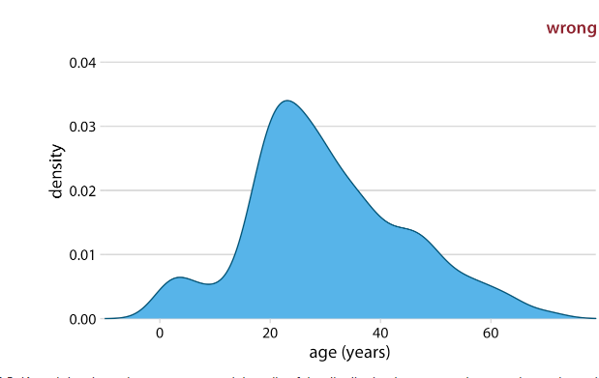
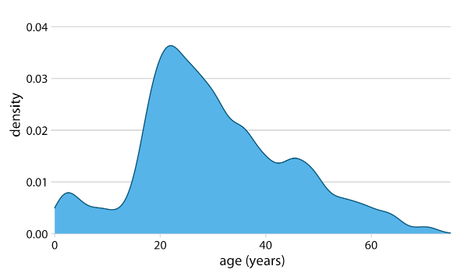
Nonparametric Density Estimation
Density curves are usually scaled such that the area under the curve equals one. This convention can make the y axis scale confusing, because it depends on the units of the x axis.
Density estimations have a tendency to produce the appearance of data where none exists, in particular in the tails

Slide 10
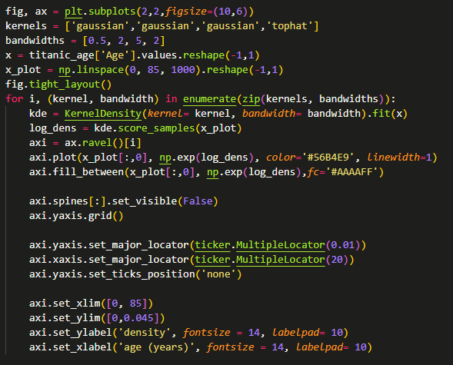
How to implement?
Different kernels
Sample dataset
Population
Training a density function with sample data
Predict the distribution

Slide 11
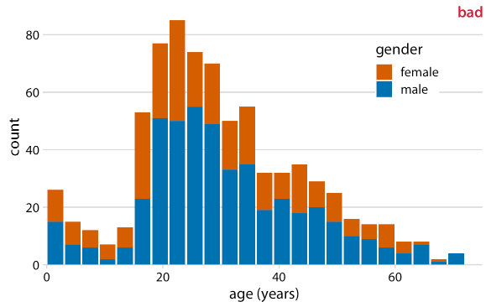
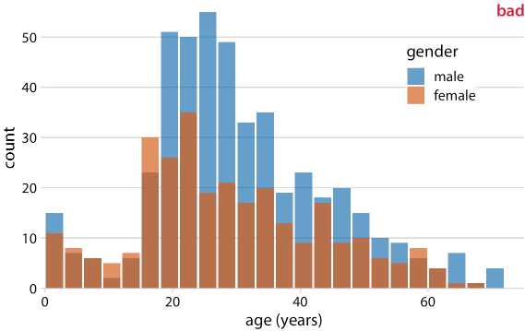
Visualizing Multiple Distributions
Notes:
First, from just looking at the figure, it is never entirely clear where exactly the bars begin. Do they start where the color changes or are they meant to start at zero? In other words, are there about 25 females of age 18–20 or are there almost 80?
Second, the bar heights for the female counts cannot be directly compared to each other, because the bars all start at a different height.
Now it appears that there are actually three different groups, not just two, and we’re still not entirely sure where each bar starts and ends. Overlapping histograms don’t work well because a semi-transparent bar drawn on top of another tends to not look like a semi-transparent bar but instead like a bar drawn in a different color.

Slide 12
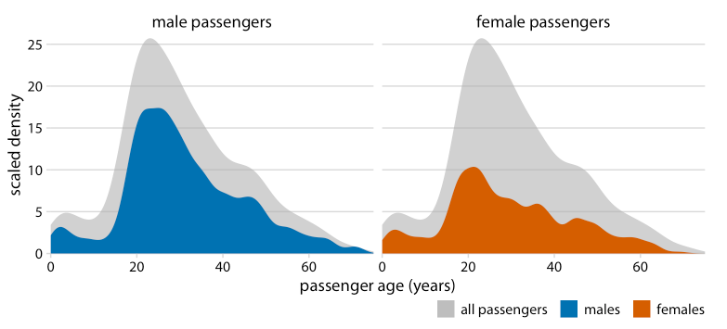
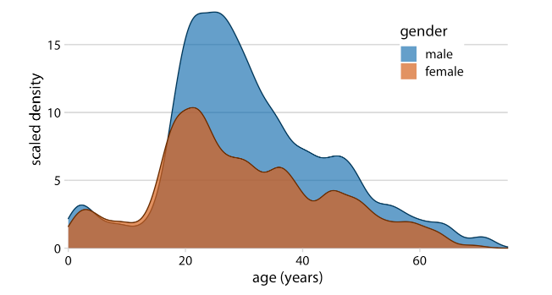
Density plots
Compare the distributions of male and female students

Slide 13
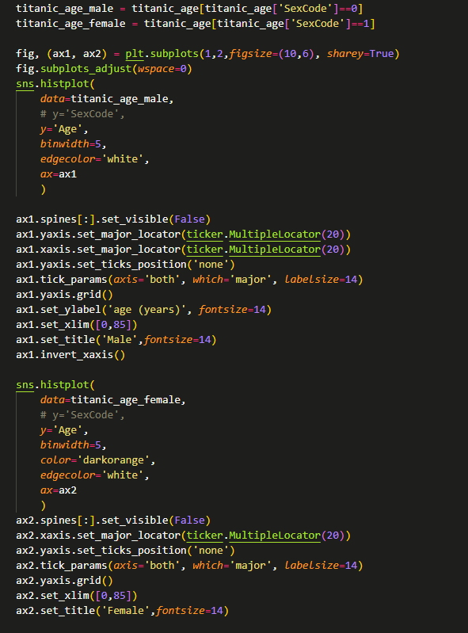
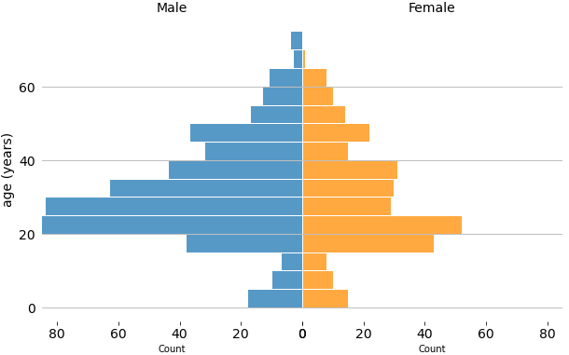
Bidirectional bar chart

Slide 14
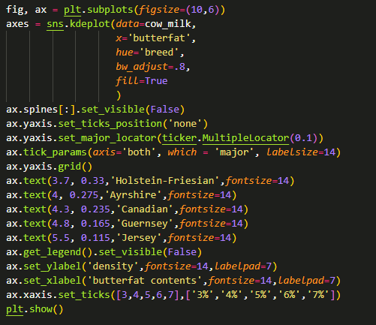
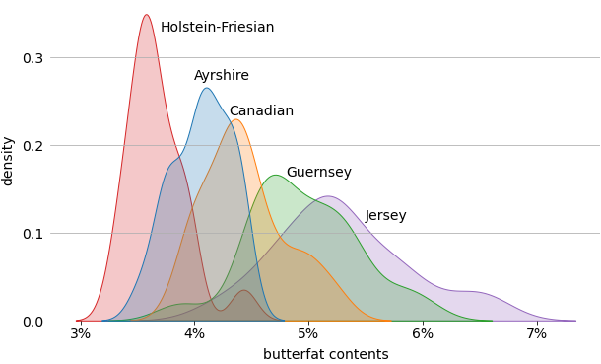
Multiple density plots

Slide 15
Additional Practice
With the student dataset, try to:
Visualize the distribution of scores with histogram and density plot
Compare the distribution of scores of male and female students with different visualizations
Visualize multiple distributions of scores of students with different educational degrees
Visualize the proportion of different degrees
Compare number of pass/fail/distinction/withdraw students with different degrees
Re-run and comment all the shared codes

